Slide 1
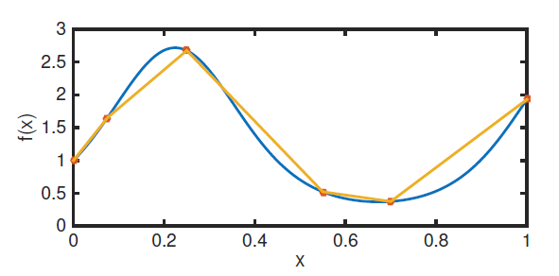
Quadrature (Integration)

Slide 2
Quadrature
To carry out integration, replace integrand with interpolant to develop approximate formula
Using interpolation theory we can get both the approximation and the error

Slide 3

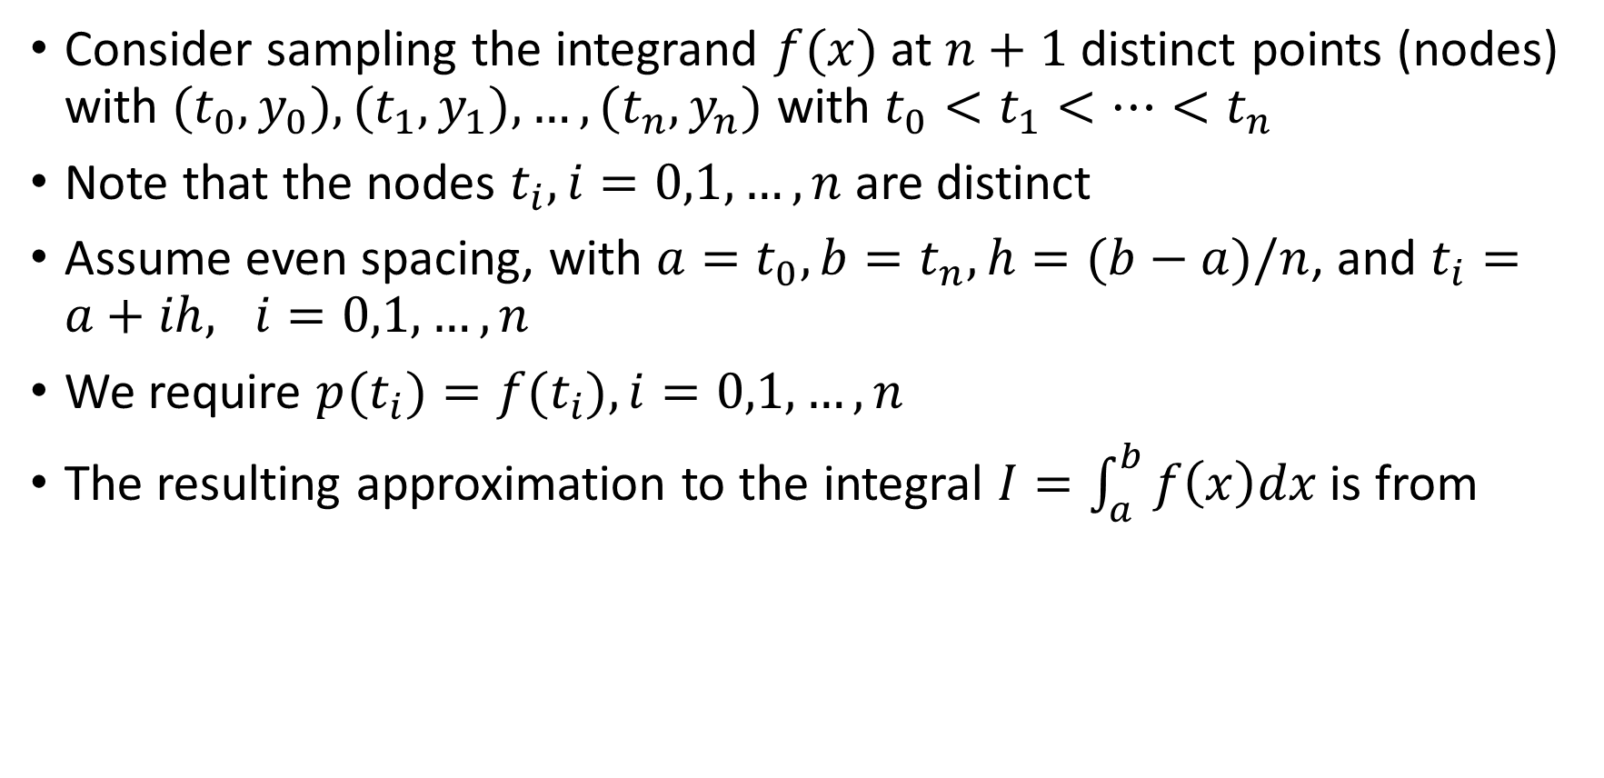
Quadrature
Consider sampling the integrand $f(x)$ at $n+1$ distinct points (nodes) with $(t_{0},y_{0}), (t_{1},y_{1}),…,(t_{n},y_{n})$ with $t_{0}<t_{1}<…<t_{n}$
Note that the nodes $t_{i}, i=0,1,…,n$are distinct
Assume even spacing, with $a=t_{0}, b=t_{n}, h=(b−a)/n$, and $t_{i}=a+ih, i=0,1,…,n$
We require $p(t_{i})={f(t}_{i}), i=0,1,…,n$
The resulting approximation to the integral $I=\int_{a}^{b}{f\left(x\right)dx}$ is from

Slide 4

Quadrature
Using this choice, we get results of the form
We should expect different weights w_i from different interpolants
We should expect more accurate methods from more accurate interpolants

Slide 5

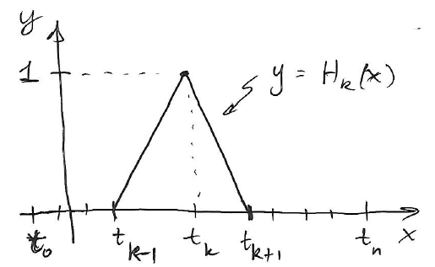


Quadrature
Let’s start with using the PL interpolant :
The hat functions satisy the cardinality conditions: 1 at the node of interest, 0 at every other node:
We choose $c_{k}=f(t_{k})$

Slide 6
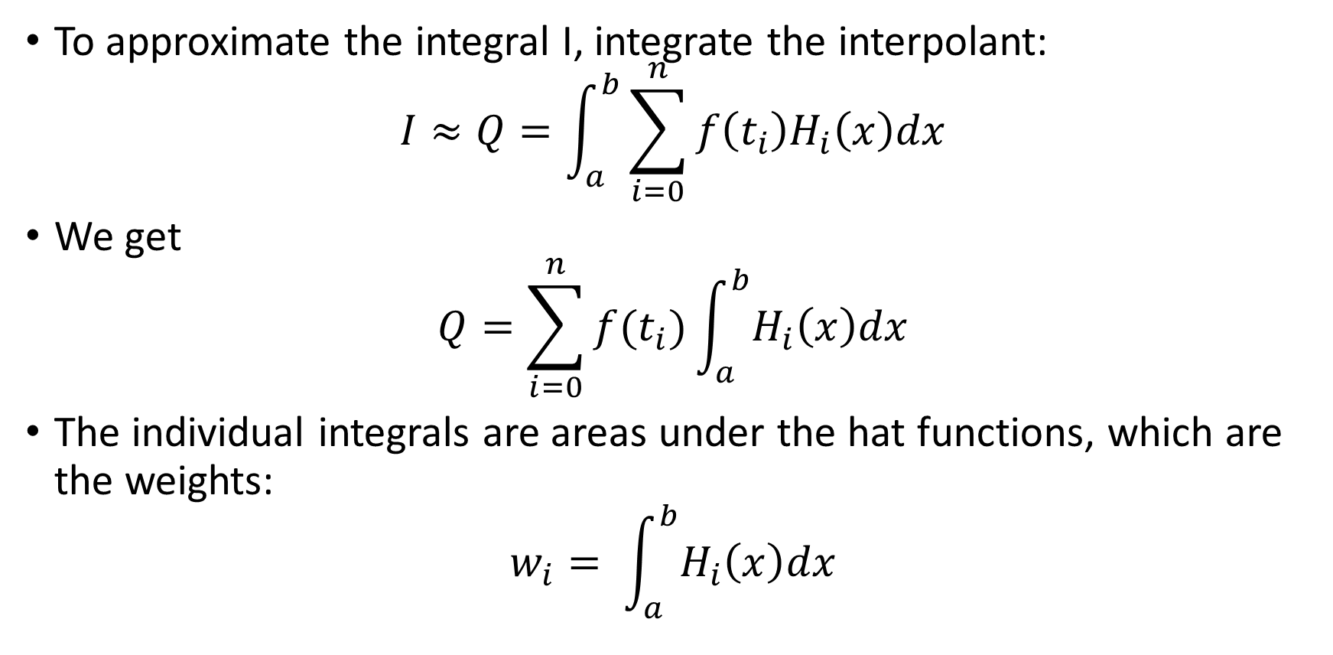
Quadrature
To approximate the integral I, integrate the interpolant:
$$I≈Q=\int_{a}^{b}{\sum_{i=0}^{n}{f\left(t_{i}\right)H_{i}\left(x\right)dx}}$$
We get
$$Q=\sum_{i=0}^{n}{f(t_{i})\int_{a}^{b}{H_{i}\left(x\right)dx}}$$
The individual integrals are areas under the hat functions, which are the weights:
$$w_{i}= \int_{a}^{b}{H_{i}\left(x\right)dx}$$

Slide 7

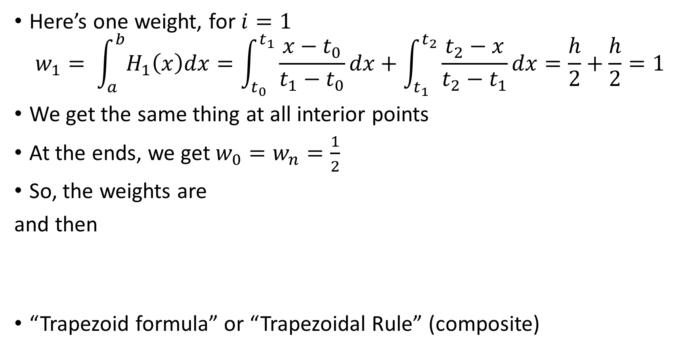
Quadrature
Here’s one weight, for $i=1$
$$w_{1}= \int_{a}^{b}{H_{1}\left(x\right)dx}=\int_{t_{0}}^{t_{1}}{\frac{x−t_{0}}{t_{1}−t_{0}}dx+\int_{t_{1}}^{t_{2}}{\frac{t_{2}−x}{t_{2}−t_{1}}dx}}=\frac{h}{2}+\frac{h}{2}=1$$
We get the same thing at all interior points
At the ends, we get $w_{0}=w_{n}=\frac{1}{2}$
So, the weights are
and then
“Trapezoid formula” or “Trapezoidal Rule” (composite)

Slide 8
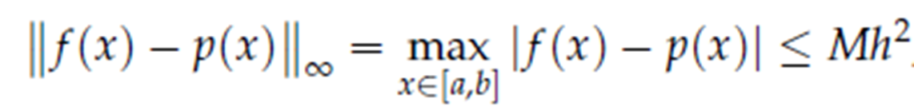
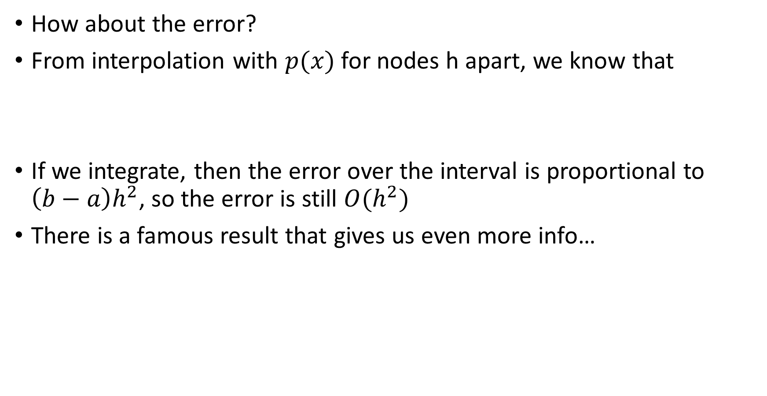
Quadrature: Trapezoidal rule
How about the error?
From interpolation with $p(x)$ for nodes h apart, we know that
If we integrate, then the error over the interval is proportional to $\left(b−a\right)h^{2}$, so the error is still $O(h^{2})$
There is a famous result that gives us even more info…

Slide 9
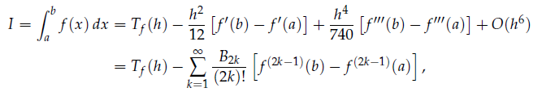
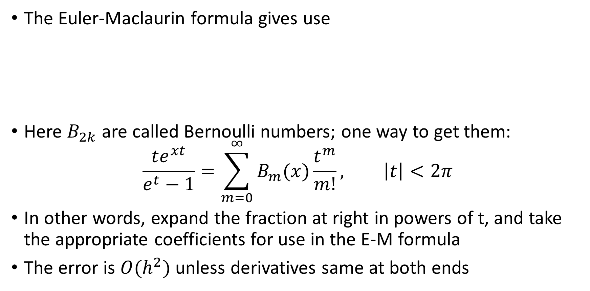
Quadrature: trapezoidal rule
The Euler-Maclaurin formula gives use
Here $B_{2k}$ are called Bernoulli numbers; one way to get them:
$$\frac{te^{xt}}{e^{t}−1}=\sum_{m=0}^{∞}{B_{m}(x)\frac{t^{m}}{m!}}, \left|t\right|<2π$$
In other words, expand the fraction at right in powers of t, and take the appropriate coefficients for use in the E-M formula
The error is $O(h^{2})$ unless derivatives same at both ends

Slide 10
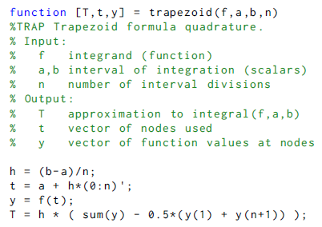

Quadrature: Trapezoidal rule
Function trapezoid.m
Assumes even grid point spacing
Input function f, endpoints $a$ and $b$, and number of subintervals $n$

Slide 11
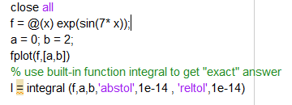
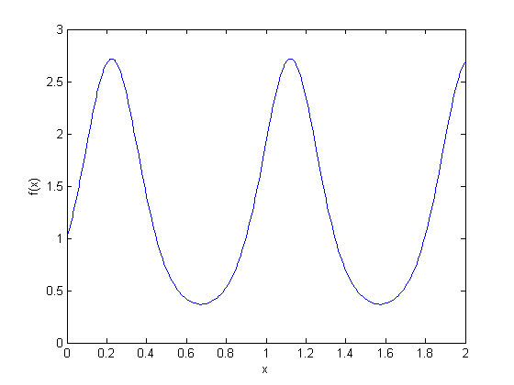

Trapezoidal rule: example
Consider $f(x) = e^{sin(7x)}⁡$on [0,2]
First use Matlab builtin integral to get “exact” answer

Slide 12
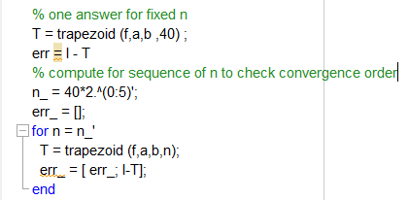
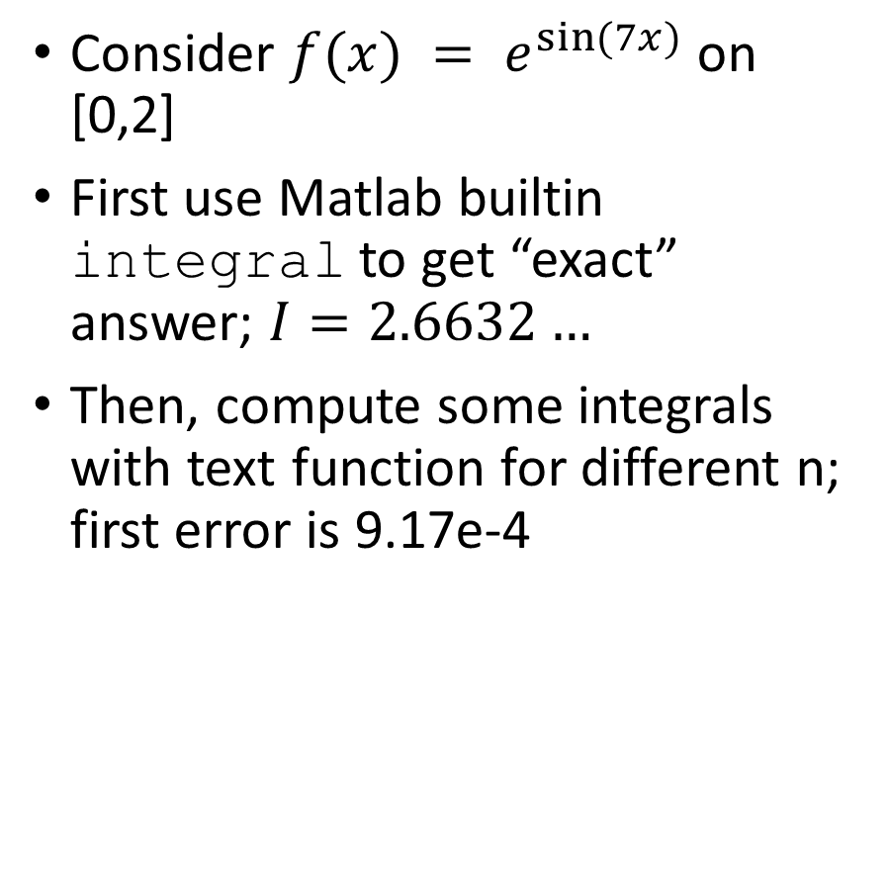
Trapezoidal rule: example
Consider $f(x) = e^{sin(7x)}⁡$on [0,2]
First use Matlab builtin integral to get “exact” answer; $I=2.6632…$
Then, compute some integrals with text function for different n; first error is 9.17e-4

Slide 13
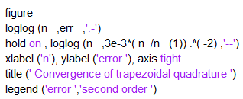
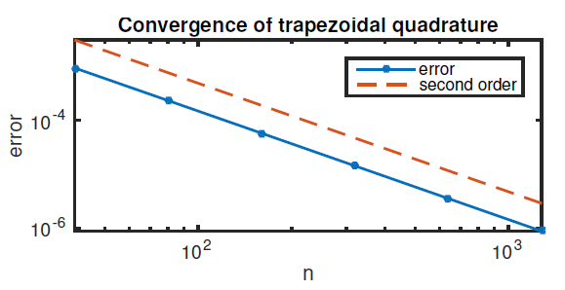
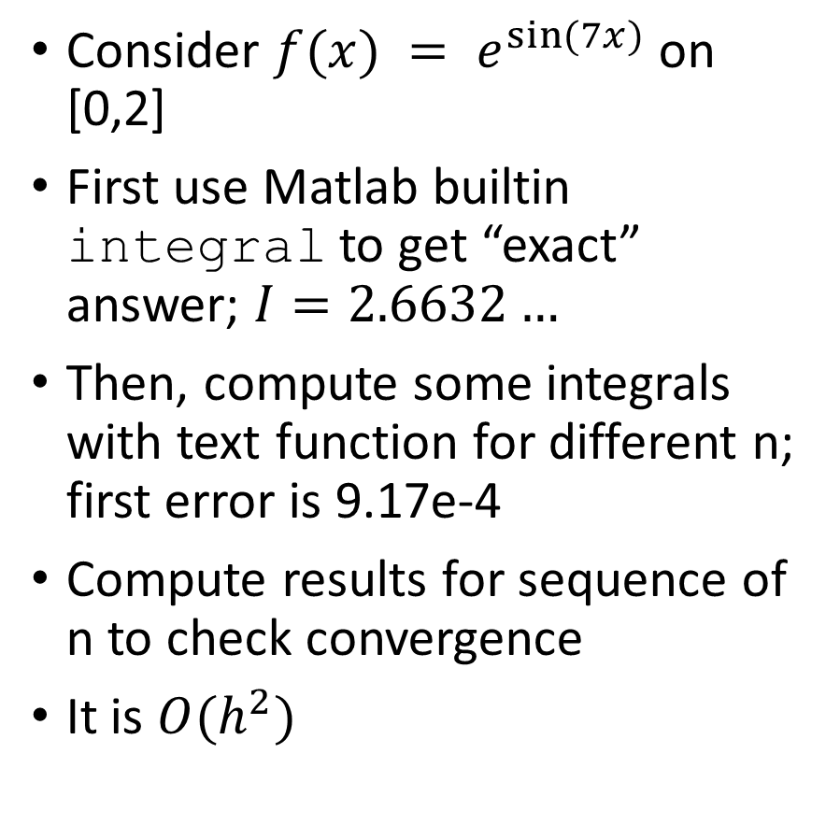
Trapezoidal rule: example
Consider $f(x) = e^{sin(7x)}⁡$on [0,2]
First use Matlab builtin integral to get “exact” answer; $I=2.6632…$
Then, compute some integrals with text function for different n; first error is 9.17e-4
Compute results for sequence of n to check convergence
It is $O(h^{2})$

Slide 14

Quadrature: Trapezoidal rule
Try some things yourself:
Try $f(x)=|sin⁡(2πx)|$for [0,2]
$f(x) = e^{sin(7x)}⁡$on $[0,2π/7]$
$f(x) =$ sawtooth(x) on [0,2]
How does the error behave in each case?

Slide 15
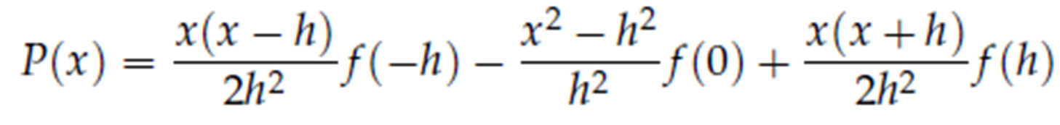
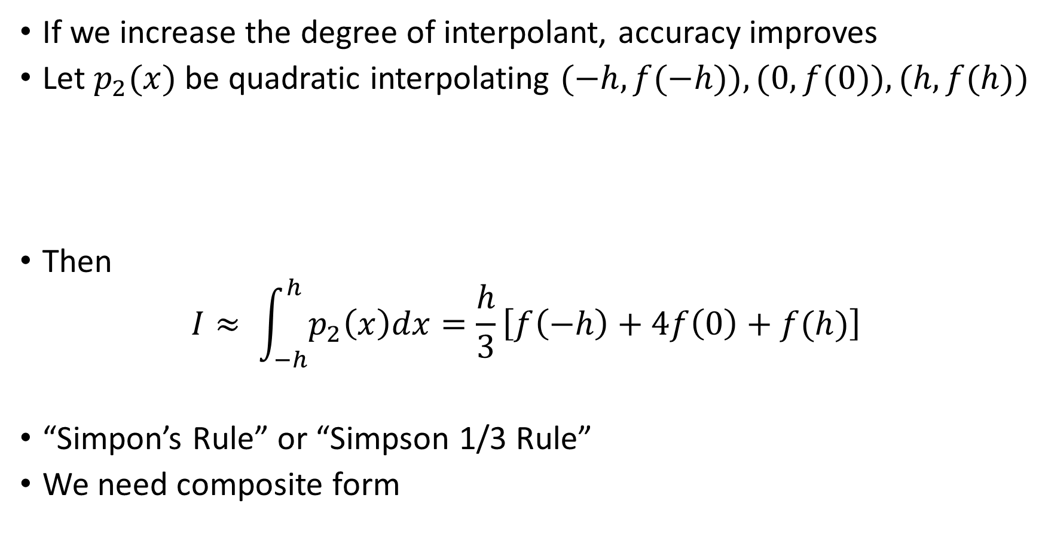
Quadrature: More Newton-Cotes rules
If we increase the degree of interpolant, accuracy improves
Let $p_{2}(x)$ be quadratic interpolating $(−h,f(−h)), (0,f(0)), (h,f(h))$
Then
$$I≈ \int_{−h}^{h}{p_{2}\left(x\right)dx}=\frac{h}{3}\left[f\left(−h\right)+4f\left(0\right)+f(h)\right]$$
“Simpon’s Rule” or “Simpson 1/3 Rule”
We need composite form

Slide 16

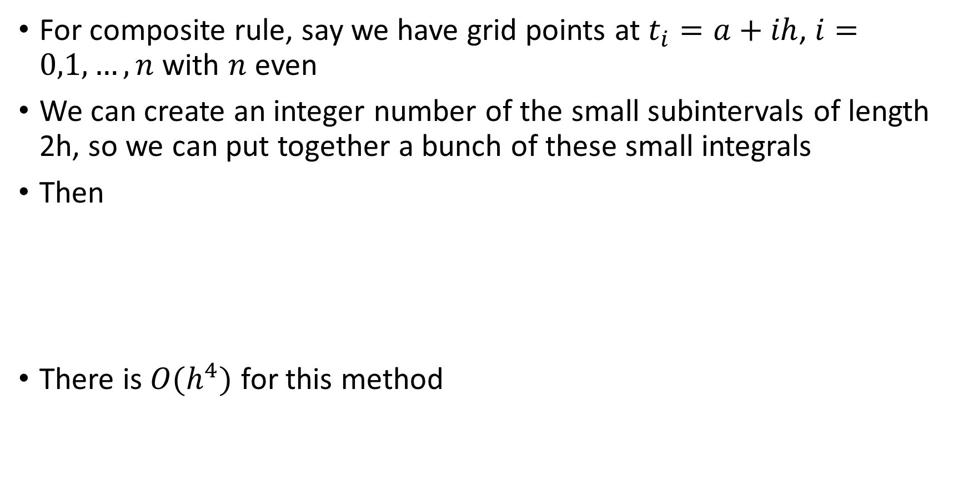
Quadrature: Simpson 1/3 rule
For composite rule, say we have grid points at $t_{i}=a+ih$, $i=0,1,…,n$ with $n$ even
We can create an integer number of the small subintervals of length 2h, so we can put together a bunch of these small integrals
Then
There is $O(h^{4})$ for this method

Slide 17
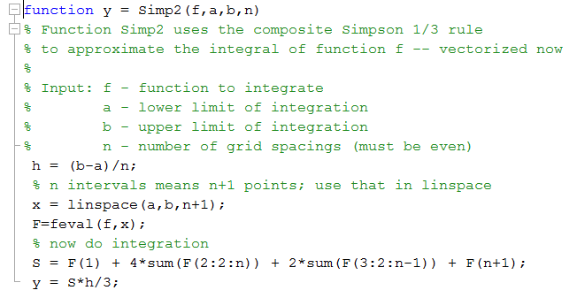
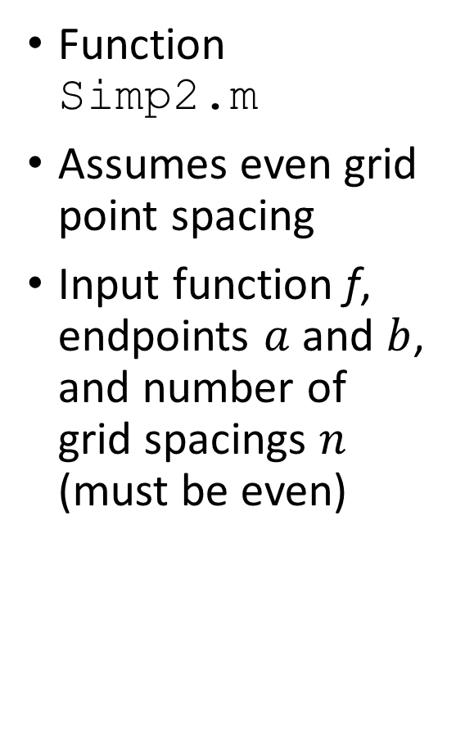
Quadrature: Simpson rule
Function Simp2.m
Assumes even grid point spacing
Input function f, endpoints $a$ and $b$, and number of grid spacings $n$ (must be even)

Slide 18
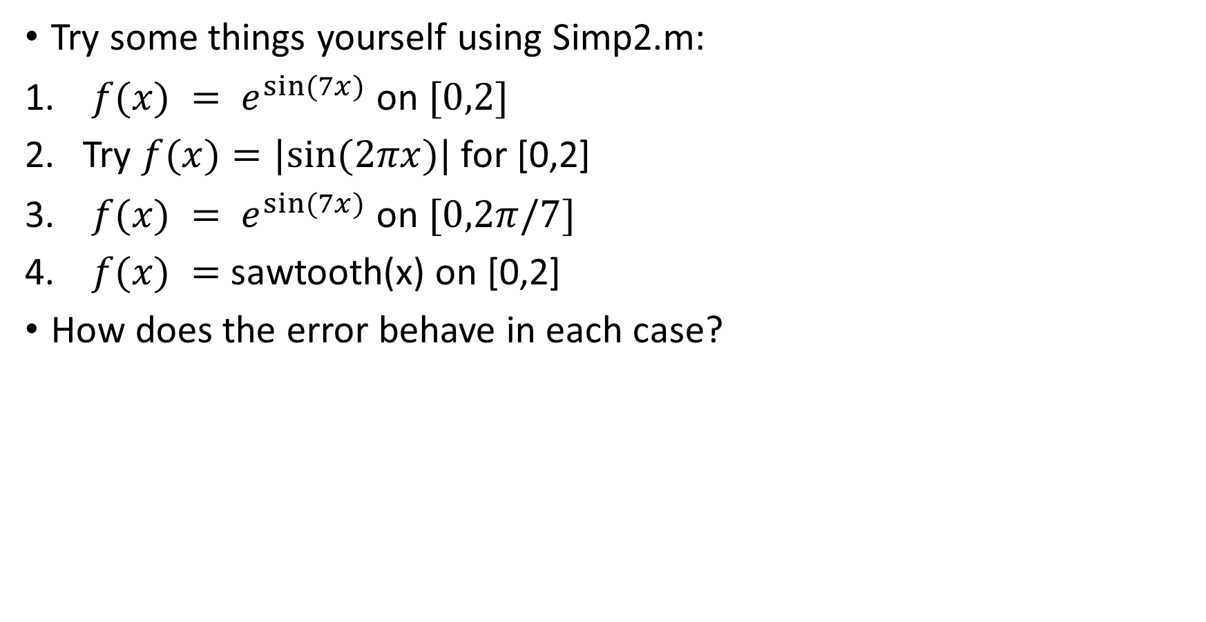
Quadrature: Simpson 1/3 rule
Try some things yourself using Simp2.m:
$f(x) = e^{sin(7x)}⁡$on $[0,2]$
Try $f(x)=|sin⁡(2πx)|$for [0,2]
$f(x) = e^{sin(7x)}⁡$on $[0,2π/7]$
$f(x) =$ sawtooth(x) on [0,2]
How does the error behave in each case?

Slide 19
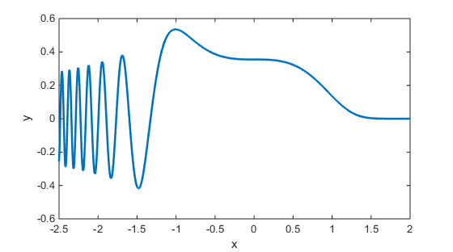
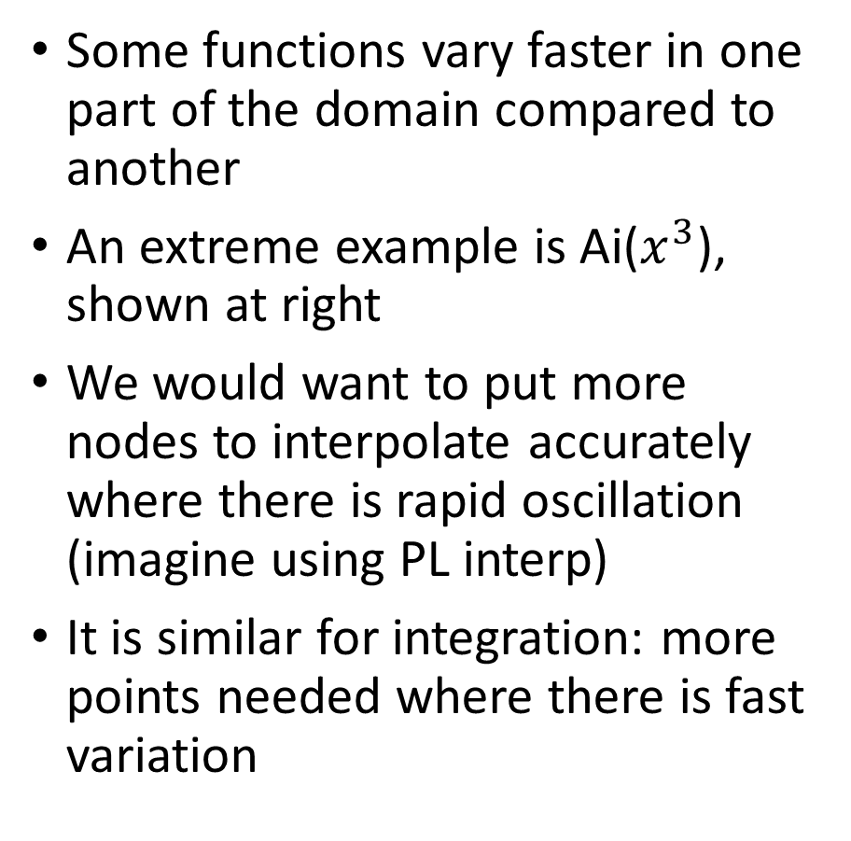
Adaptive Quadrature
Some functions vary faster in one part of the domain compared to another
An extreme example is Ai($x^{3}$), shown at right
We would want to put more nodes to interpolate accurately where there is rapid oscillation (imagine using PL interp)
It is similar for integration: more points needed where there is fast variation

Slide 20
Adaptive Quadrature
Strategy: estimate error using knowledge of Simpson rule
Start by one and two intervals over whole domain
Apply Simpson rule on all intervals
Estimate error; if larger than tolerance, then subdivide again in half that did not satisfy tolerance (could be one or both)
Recursively do this in each subdomain

Slide 21
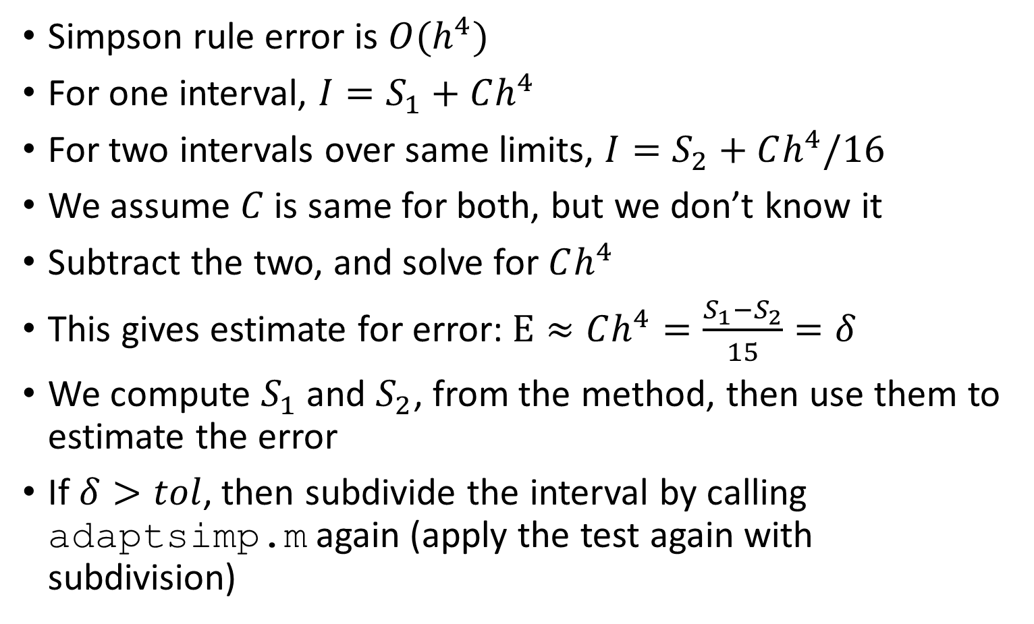
Adaptive Quadrature
Simpson rule error is $O(h^{4})$
For one interval, ${I=S}_{1}+Ch^{4}$
For two intervals over same limits, ${I=S}_{2}+Ch^{4}/16$
We assume $C$ is same for both, but we don’t know it
Subtract the two, and solve for $Ch^{4}$
This gives estimate for error: $E≈Ch^{4}=\frac{S_{1}−S_{2}}{15}=δ$
We compute $S_{1}$ and $S_{2}$, from the method, then use them to estimate the error
If $δ>tol$, then subdivide the interval by calling adaptsimp.m again (apply the test again with subdivision)

Slide 22
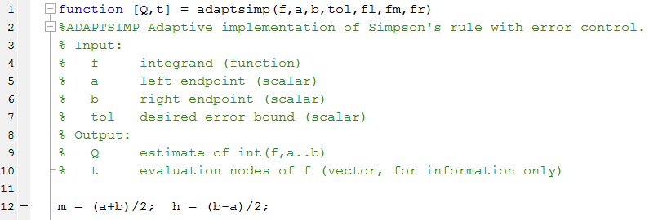
Adaptive Quadrature

Slide 23
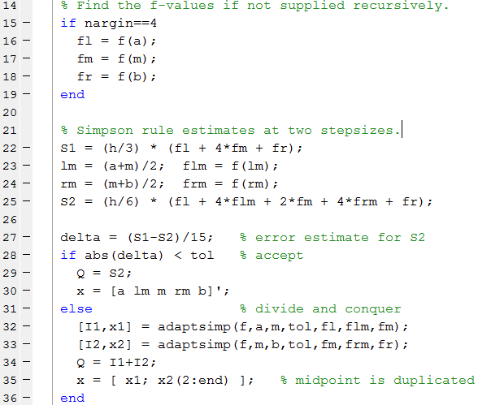
Adaptive Quadrature

Slide 24
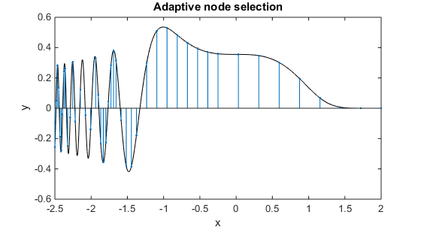
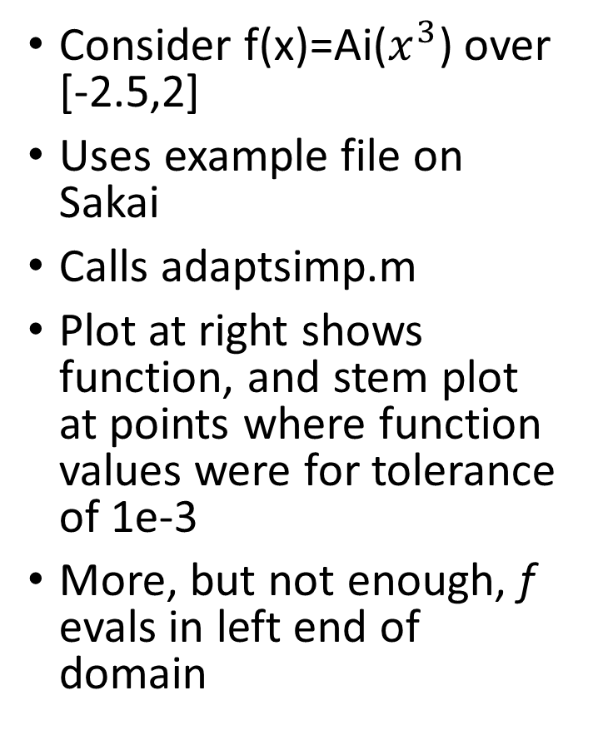
Adaptive Quadrature example
Consider f(x)=Ai($x^{3}$) over [-2.5,2]
Uses example file on Sakai
Calls adaptsimp.m
Plot at right shows function, and stem plot at points where function values were for tolerance of 1e-3
More, but not enough, f evals in left end of domain

Slide 25
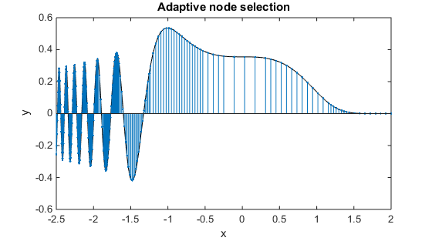
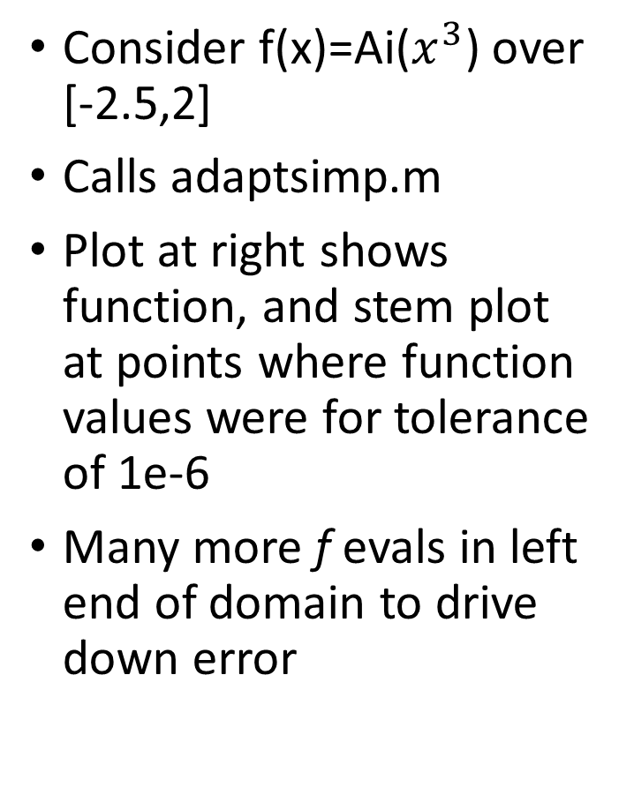
Adaptive Quadrature example
Consider f(x)=Ai($x^{3}$) over [-2.5,2]
Calls adaptsimp.m
Plot at right shows function, and stem plot at points where function values were for tolerance of 1e-6
Many more f evals in left end of domain to drive down error

Slide 26
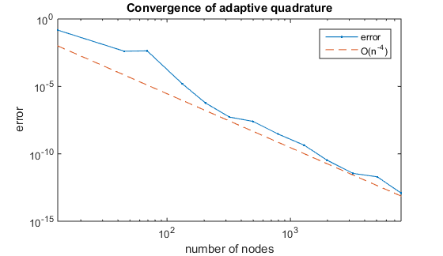
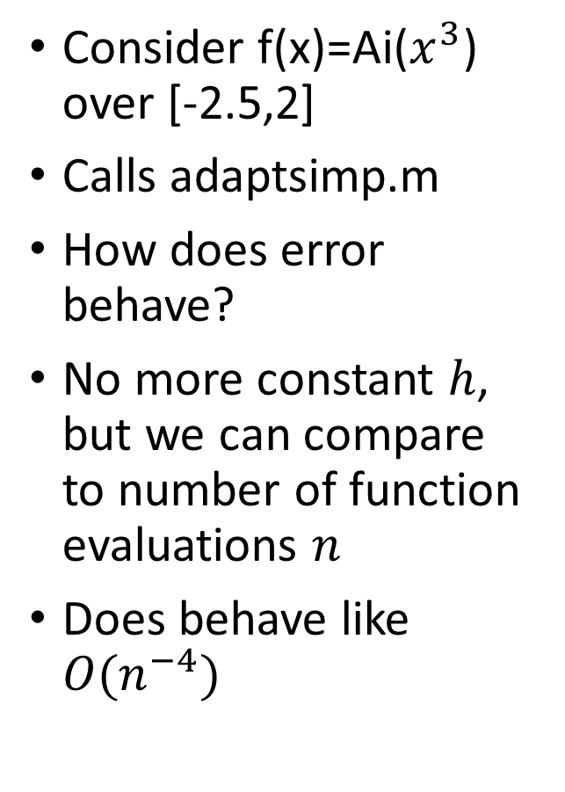
Adaptive Quadrature example
Consider f(x)=Ai($x^{3}$) over [-2.5,2]
Calls adaptsimp.m
How does error behave?
No more constant $h$, but we can compare to number of function evaluations $n$
Does behave like $O(n^{−4})$

Slide 27
Adaptive Quadrature
Try: a different function that oscillates faster or changes rapidly in a different part of the domain.

Slide 28
Adaptive Quadrature
Text approach is based on extrapolation
Skipping that approach this semester

